Slide 1
Notes:
1

Slide 2
Epidemiology of HUS in Egypt
Ihab El Hakim
Professor of Pediatric Nephrology
Ain Shams University

Slide 3
Agenda
International prevalence
Prevalence in Egypt
Conclusion

Slide 4
Although not well established, the estimated annual incidence of aHUS in the USA is one in 500,000 individuals and seven in one million individuals in Europe

Slide 5
Eight articles were included in this review. HUS had an annual crude incidence of 0.66 per 100,000 people and a standard annual incidence of 0.57 per 100,000 people. Females were more likely than males to develop HUS, but only marginally more frequently. Patients under 20 years old were the age group where HUS was most common.
Children had the greatest incidence rate, with 5.08 per 100,000 person-years annually. But earlier studies from Europe and North America revealed that children under five were the most often impacted.

Slide 6
Study | Year | Country | Ped/all | Number | Females
Robitaille et al. | 2012 | Canada | Ped | 337 | n/s
Jenssen et al. | 2014 | Norway | Ped | 47 | 32
Ardissino et al. | 2016 | Italy | Ped | 101 | 46
Alshaaili et al. | 2018 | Oman | All | 36 | 15
Ashida et al. | 2018 | Japan | Ped | 258 | 140
Alfandary et al. | 2020 | Israel | Ped | 75 | 40
Beczkiewicz et al. | 2020 | USA | All | 74 | 44
Capone et al. | 2021 | Italy | Ped | 100 | 39

Slide 7
The majority of patients were young with a mean age (SD) of 10.68 (14.07) years. Youngest was 6 months old while the oldest was 46 years old, and 21 (58.33 %) patients were males.

Slide 8
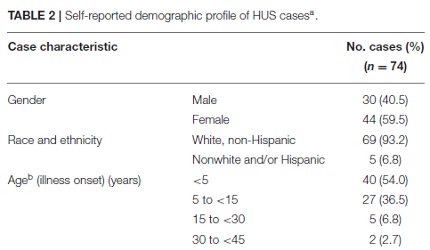

Slide 9
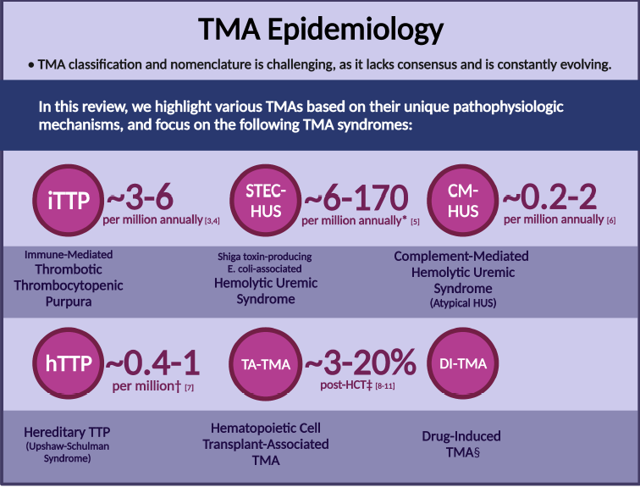

Slide 11
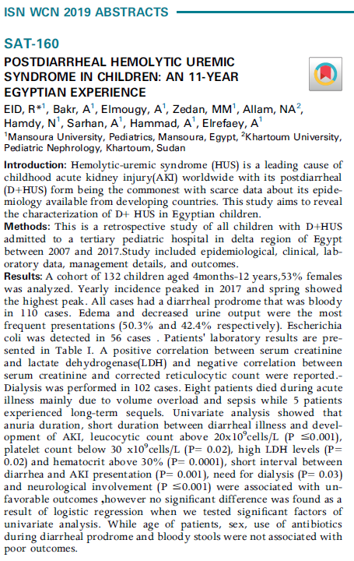
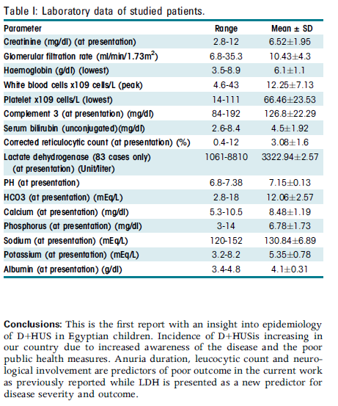

Slide 12
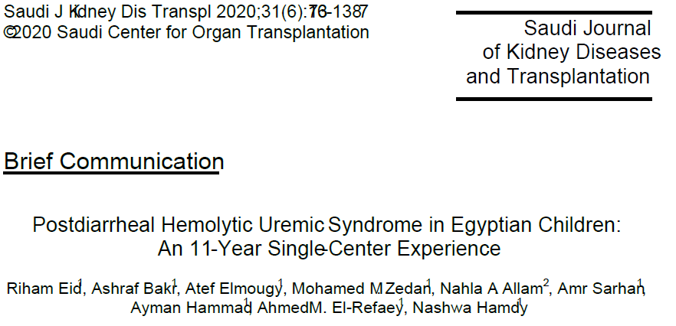
A retrospective study of children aged below 18 years diagnosed with D+HUS in Mansoura University Children Hospital, Egypt from January 2007 to December 2017.

Slide 13
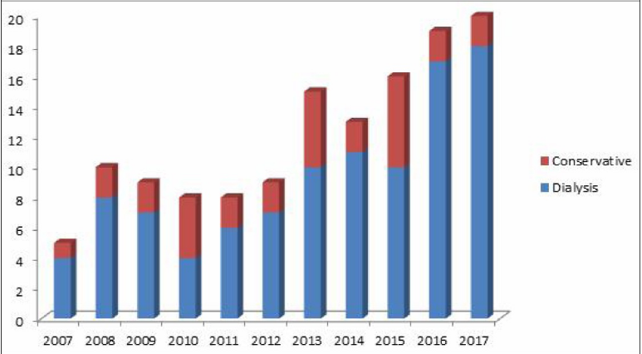

Slide 14
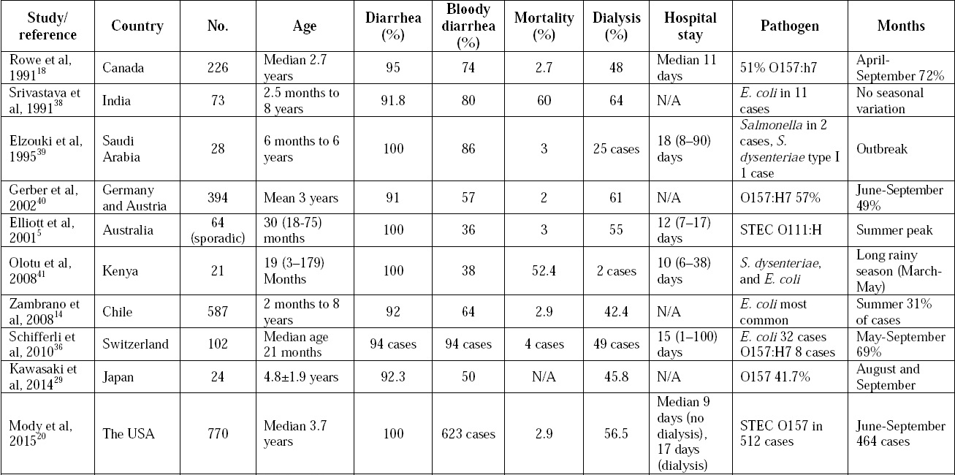

Slide 16
Fifty HUS patients were recruited from the Pediatric Department of Cairo University Children Hospital between March 2018 and July 2019.
Of the 50 HUS patients, 28 (56%) were males and 22 (44%) were females, with a mean age of 4.1 ± 3.6 years (range, 6 months to 12 years).
(i) 22 typical HUS patients (44%) due to STEC infection evidenced by a positive Shiga toxin assay
(ii) 12 aHUS patients (24%) were positive for serum anti-FH
(iii) 16 aHUS patients (32%) were negative for anti-FH and showed no evidence of STEC infection

Slide 17
In conclusion, this work showed that Egypt potentially has one of the highest reported frequencies of AI-HUS. Hence, we highlight the importance of the rapid detection of anti-FH and make the assay readily available for children with aHUS, especially older ones.

Slide 19
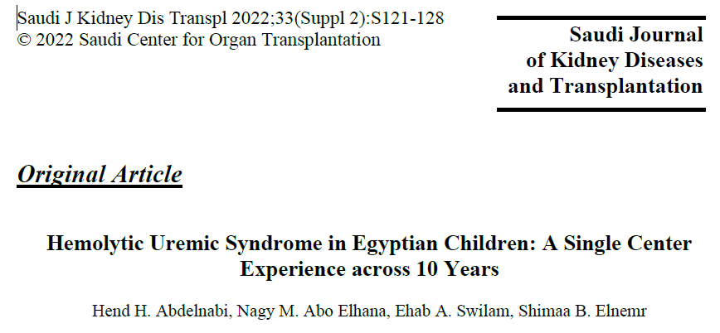
This retrospective cohort study used 10 years of hospital-based records of HUS cases among children hospitalized in the Pediatric Nephrology Unit, Tanta University Hospitals, between January 2009 and January 2019.

Slide 20
The incidence of HUS has increased in Egypt in the last 5 years, with a higher incidence of STEC-HUS than atypical HUS.

Slide 22
Retrospective and prospective cohort study from Pediatric Nephrology and pediatric intensive care departments in Zagazig University Hospital from Mars 2022 to February 2023. We conducted it on 48 children under 16 years old diagnosed to have hemolytic uremic syndrome.

Slide 23
The incidence of typical HUS is higher than atypical HUS, which occurs more frequently in males than females.

Slide 25
TMA Cases Children’s Hospital- ASU
January 2013 to October 2023

Slide 26
Center | Period | Duration | Total | Typical | atypical | Age range | Incidence/m
Mansoura | Jan 2007-Dec 2017 | 11y | 132 | 132 (100) | 0 | 4m-12y | 1
Cairo | Mar 2018-July 2019 | 1 4/12 | 50 | 22 (44) | 28 (56) | 6m-12y | 3.125
Tanta | Jan 2009-Jan 2019 | 10y | 68 | 63 (92.65) | 5 (7.35) | 6m-13y | 0.57
Zagazig | Mar 2022-Feb 2023 | 11m | 48 | 29 (60.4) | 19 (39.6) | 3m-12y | 7.64
Ain Shams | Jan 2013-Oct 2023 | 10 10/12 | 144 | 90 (62.5) | 54 (37.5) | 2.5m-16y | 1.1

Slide 27
Conclusion
An Egyptian registry for cases of TMA among the pediatric population is urgently needed.

